Slide 1
Resources
Module 06
“Get the right people. Then no matter what all else you might do wrong after that, the people will save you. That’s what management is all about.” – Tom DeMarco
Notes:
Tom DeMarco is a software engineer who pioneered structure analysis.

Slide 2
Agenda
Creating Resources
Cost
Calendars
Types
Assigning Resources
Initial Assignment
Adjusting Resources
Implications to Work, Duration, Resource

Slide 3
Schedule development Stages
Schedule development Stages
Task Entry (Module 1)
Project Level Task
Task Logic (Module 1 & 2)
What comes next?
Task Constraints (Module 2)
Resource Creation and Allocation (Module 3)
Schedule Balancing (Module 5 & 6)
Triple Constraint Management
Sub-Deliverables
Work Packages/Products
Activities
Milestones
Support Activities (Meetings)
What do I need to start?
Is there a delay before next task
What must happen on a particular date?
What must happen before/after a date
When should I finish this task
What People (work) resources
What machines (work)
What materials (materials)
What extra costs (costs)
Overallocation of resources removed
Schedule dates met
Cost Constraints met
Variances
Analyze
Adjust
Reporting/Exporting/Importing

Slide 4
Adding resources
Understand the different types of resources
Able to add a resource to a project

Slide 5
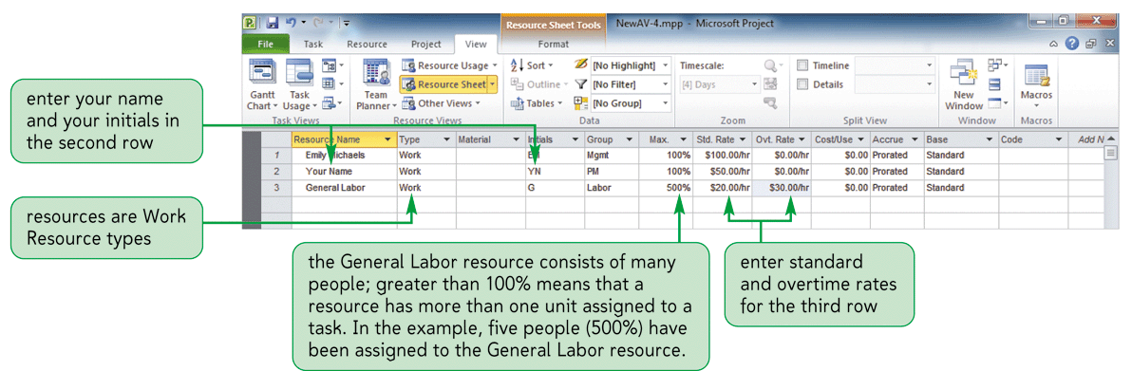
Creating Resources – Basic Setup
Resource Types:
Work – People resource that works on a task
Material – Resources consumed while working on tasks ex. Bricks
Cost – Specific project costs ex. Travel, Delivery Charges
(See notes below this slide)
Source: Bunin, New Perspectives on Microsoft Project 2010
Notes:
Material Label Field to define the unit of measure for a material resource. For instance lbs for pounds, bx for box.
The Group Field is used to enter a label or keyword that you can use for organizing (sorting, grouping or filtering) resources, ex. Testers
Cost per Use is a special, one time cost per assignment that is independent of the hours worked. Ex Renting equipment – charged once for each 100% used.
Add New Resources Automatically – Backstage, Advanced – if you turn it off you will be warned if resource is not in resource pool
Overtime rates can only be applied if you populate the Overtime Work column
Image Source: Bunin, New Perspectives on Microsoft Project 2010

Slide 6
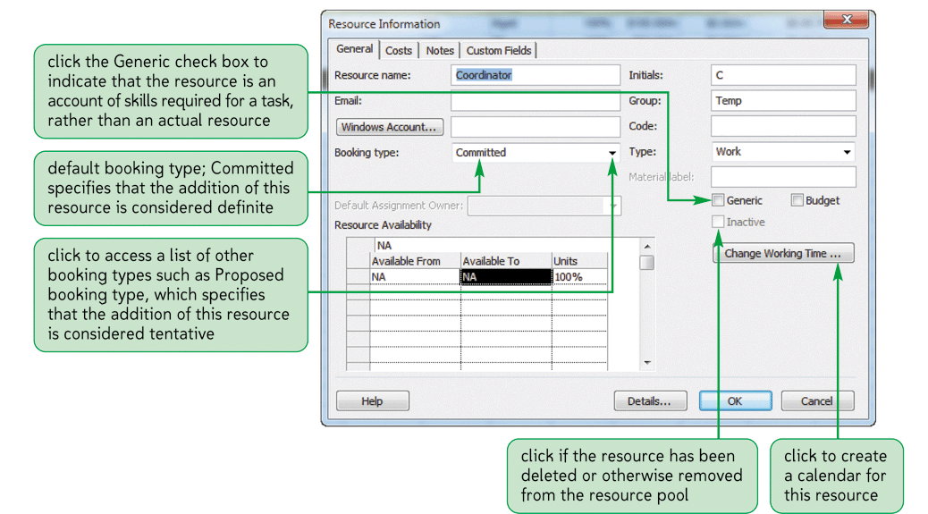
Entering Resources – Resource Options
Source: Bunin, New Perspectives on Microsoft Project 2010
Notes:
Image Source: Bunin, New Perspectives on Microsoft Project 2010

Slide 7
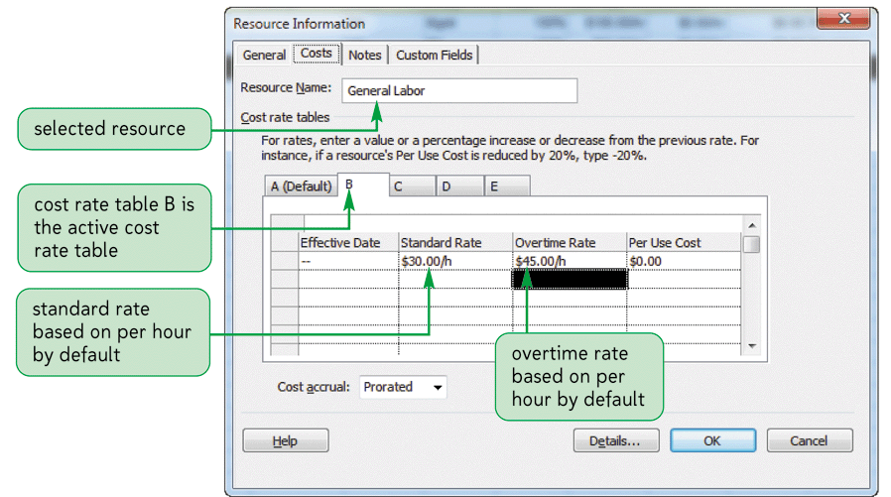
Assigning Costs
Source: Bunin, New Perspectives on Microsoft Project 2010

Slide 8
Assigning Costs – Advanced Options
Source: Bunin, New Perspectives on Microsoft Project 2010
Notes:
Image Source: Bunin, New Perspectives on Microsoft Project 2010

Slide 9
Resource Creation Completed
Key concepts:
Ensure you put in default cost
Ensure you understand the Type
Only use calendar when necessary
Use meaningful Initials

Slide 10
Adding a Resource
Open new project
Select resource tab
Add a resource
Double click to bring up Information Dialog
Review fields

Slide 11
Assigning Resources
Understand the different types of resources
Able to add a resource to a project

Slide 12
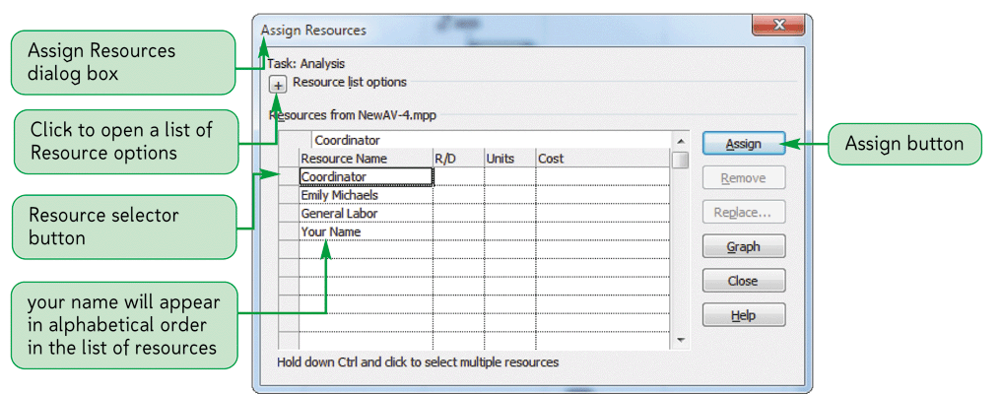
Assigning Resources to Tasks
Source: Bunin, New Perspectives on Microsoft Project 2010
Notes:
Image Source: Bunin, New Perspectives on Microsoft Project 2010

Slide 13
Resource Assignment Completed
Key concepts:
Ensure you put resources on all tasks
excluding summary and milestone
Pay attention any change after initial assignment
Watch what changes when you assign resources
Validate correct resource type based on task
Save … Save … Save
Let’s try it!

Slide 14
Assigning a Resource
Open project
Select a task
Add columns
Type
Effort
Work
Add resources

Slide 15
The Formula
Understand types of Resource to Task Assignments
Able to identify correct relationship type to assign

Slide 16
Task Resource Assignment TyPe
There are 3 Task types:
Fixed Duration
Fixed Units
Fixed Work
Each of these will determine how your project duration, work and resource units are managed by MS Project.

Slide 17
Task Considerations – Fixed Units
Fixed unit tasks means that in the formula Duration * Units = Work the units are fixed. Use Fixed Unit tasks in situations such as:
When the number of resources you have for the task is the first or main thing you know.
When you can’t get more resources to do the work — your resources are fixed.
When you want to change the duration or the work on a task while keeping the number of people working on the task the same (assignment units).
When you want to keep the resource working on a task at a certain percentage of his or her available hours.
Here are a few tips about this type of task:
This type usually isn’t used as much as fixed work and fixed duration.
Fixed unit is Project’s default.
Note! I rarely used fixed units. I mainly use fixed work and fixed duration.
Notes:
https://www.mpug.com/articles/task-types-dont-get-frustrated/
Written by John Reinheimer

Slide 18
Task Considerations – Fixed Work
Fixed work tasks means that in the formula Duration * Units = Work the work is fixed. Use Fixed Work tasks in situations such as:
When the effort required is the first thing you estimate.
When the effort required is the easiest thing to estimate. Estimating effort is usually easier and more accurate than estimating duration.
When your resources give you task estimates in work hours. For example, developers and engineers typically give work estimates in hours.
Notes:
https://www.mpug.com/articles/task-types-dont-get-frustrated/
Written by John Reinheimer

Slide 19
Task Considerations – Fixed Duration
Fixed duration tasks means that in the formula Duration * Units = Work the duration is fixed. Use Fixed Duration tasks in situations such as:
When the duration is the first thing you estimate.
If the duration stays the same when adding resources, such as training or backing up a computer system.
Tasks that always have a group of resources assigned, such as meetings or training.
When the deadline is so tight that it’s the primary driver for the duration of the task. You have to make it work within the available timeframe. This situation has been prevalent in most of the organizations I’ve worked with.
When the workload isn’t your problem, such as when external resources are consultants.
Notes:
https://www.mpug.com/articles/task-types-dont-get-frustrated/
Written by John Reinheimer

Slide 20
Task Considerations – Guideline #1
There are two simple guidelines to remember when determining task types. If you remember these guidelines, you’ll be able to predict how Microsoft Project will respond as you enter duration, units, and/or work.
Guideline #1: Enter the duration estimate or work estimate and fix that number by setting the Task Type accordingly. Fixing it prevents Project from changing it.
If you enter a Duration estimate, set the Task Type to Fixed Duration.
If you enter a Work estimate, set the Task Type to Fixed Work.
Notes:
https://www.mpug.com/articles/task-types-dont-get-frustrated/
Written by John Reinheimer

Slide 21
Task Considerations – Guideline #2
Guideline #2: Provide the second value in the formula Duration * Units = Work and let Project calculate the third value. If you created a fixed duration task, assign the resources you need and let Project calculate the work. If you created a fixed work task, assign the resources and let duration be calculated. If you entered the duration and work, Project only needs to know who will do the task and it will calculate the number of resources needed (units).
Note! Always provide only two of the three values in the formula.
Notes:
https://www.mpug.com/articles/task-types-dont-get-frustrated/
Written by John Reinheimer

Slide 22
Duration/Work/Units
Work formula:
Work=Duration*Units
Effort-driven Scheduling (default): work remains constant and duration changes - existing or new resources are modified

Slide 23
Duration/Work/Units
Fixed-duration Tasks (when effort-driven scheduling is turned off): the duration of the task remains constant, more resources are added, and the work (effort) increases

Slide 24
Changing Resource Assignments
Understand the impact of various resource assignments
Predict changes to work, duration and units if one is changed

Slide 25
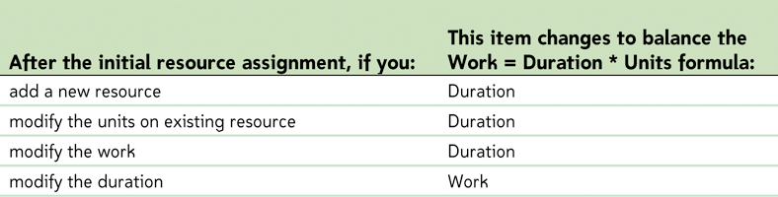
Duration/Work/Units
Source: Bunin, New Perspectives on Microsoft Project 2010
Notes:
Image Source: Bunin, New Perspectives on Microsoft Project 2010

Slide 26
Duration/Work/Units
Work=Duration*Units
And you change one of these
Task Type
This Changes
Source: Bunin, New Perspectives on Microsoft Project 2010
Notes:
https://www.youtube.com/watch?v=k52Zk0rmaIs
[SparQ Corporate Training (October 5, 2013). Microsoft Project task types & scheduling formula.]

Slide 27
Changing Resources
Review the changes possible and the impacts
Show each type of resource
Modify one and see changes

Slide 28
Video Resources

Slide 29
Video Resources
Resource Assignment
http://www.youtube.com/watch?v=xqTHojeJWnw.
Simon Sez IT (April 16, 2013). Microsoft Project 2013 tutorial - Resource basics. Retrieved January 30, 2014, from
Work/Duration/Units
http://www.youtube.com/watch?v=k52Zk0rmaIs
[SparQ Corporate Training (October 5, 2013). Microsoft Project task types & scheduling formula.]
Resource Assignment
http://www.youtube.com/watch?v=xqTHojeJWnw
[Simon Sez IT (April 16, 2013). Microsoft Project 2013 tutorial - Resource basics. ]

